Slide 2

7.1 Convolutional Neural Network
교재 p 228
CNNs are basically layers of convolutions followed by subsampling and fully connected layers.
Intuitively speaking, convolutions and subsampling layers works as feature extraction layers while a fully connected layer classifies which category current input belongs to using extracted features.

Slide 3

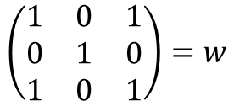
7.2.2 Convolution
교재 p 230
$$\left(\begin{matrix}1 & 0 & 1 \\ 0 & 1 & 0 \\ 1 & 0 & 1\end{matrix}\right)=w$$
Convolution Filter = Kernel = Weight = Weight Matrix = W
http://deeplearning.stanford.edu/wiki/index.php/Feature_extraction_using_convolution
Notes:
컨볼루션은 이미지의 특성을 뽑아내는 단순한 연산입니다. 노란색의 커널 또는 필터라고 불리우는 3 by 3 행렬을 5 by 5 이미지위에 슬라이딩해 가면서 그 결과인 Feature map을 만들게 되는데요. 앞서 소개드렸던 wx+b 과정이 전부 matrix 단위로 이루어진다는 특징이 있습니다.

Slide 4
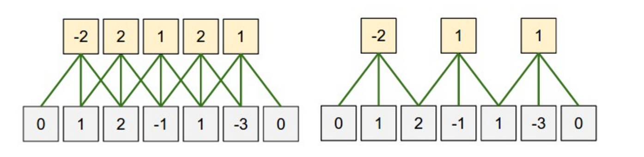
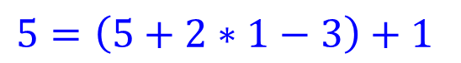
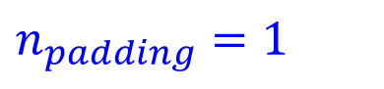
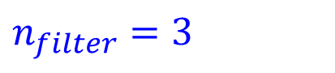

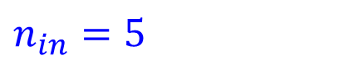
7.2.3 Zero-padding
교재 p 232
What is the size of the input?
$n_{in}=5$
What is the size of the output?
$n_{out}=5$
What is the size of the filter?
$n_{filter}=3$
What is the size of the zero-padding?
$n_{padding}=1$
$n_{out}=\left(n_{in}+2∗n_{padding}−n_{filter}\right)+1$
$5=\left(5+2∗1−3\right)+1$

Slide 5
7.2.4 Stride
교재 p 233
(Left) Stride size: 1
(Right) Stride size: 2
If stride size equals the filter size, there will be no overlapping.

Slide 6

Convolutional Layers

Slide 7
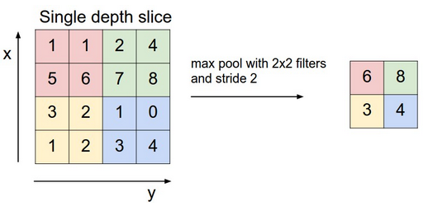
7.3 Pooling/Downsampling
교재 p 240
Credit to Andrej Karpathy

Slide 8
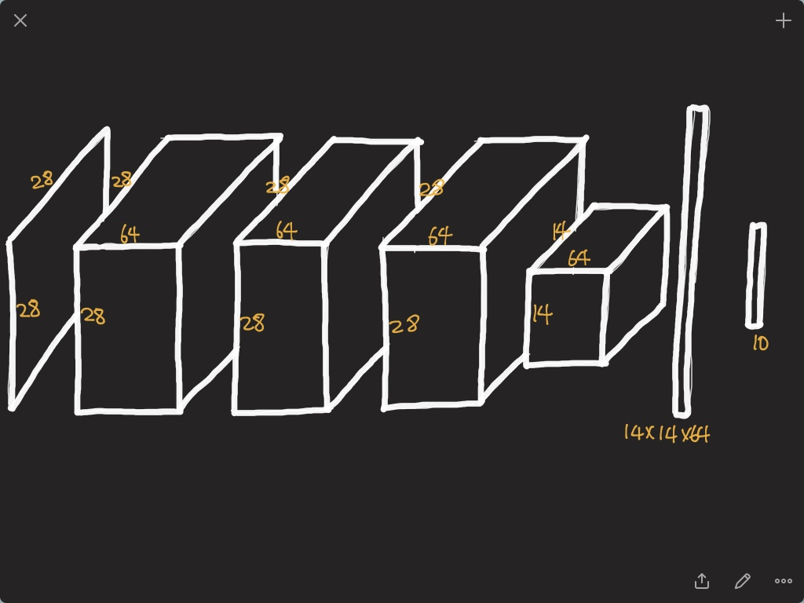
Credit to Sungjoon Choi

Slide 9
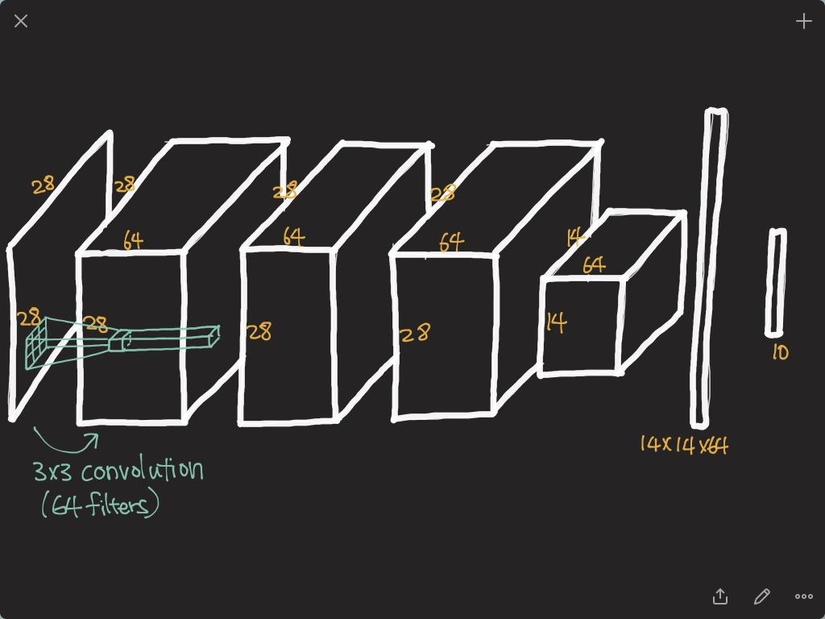

Slide 10
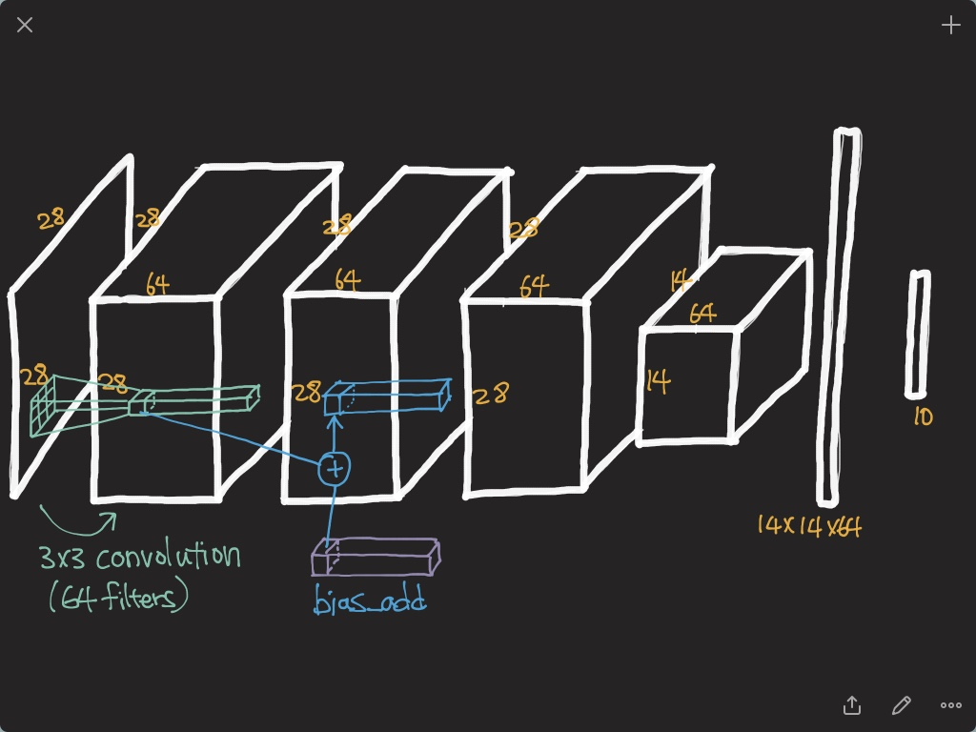

Slide 11
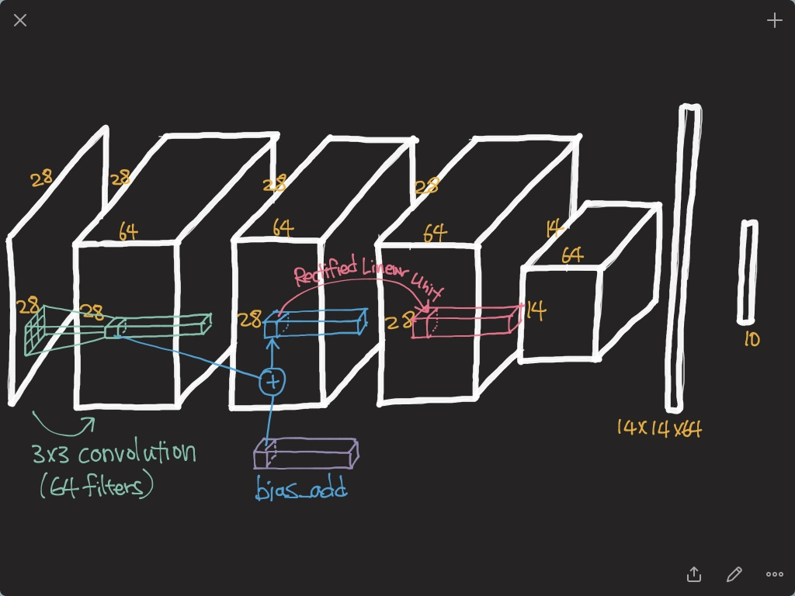

Slide 12
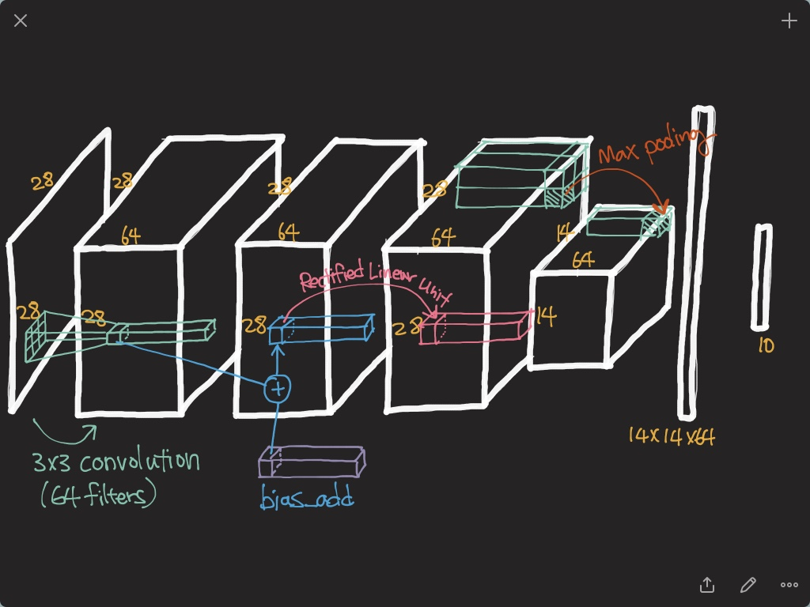

Slide 13
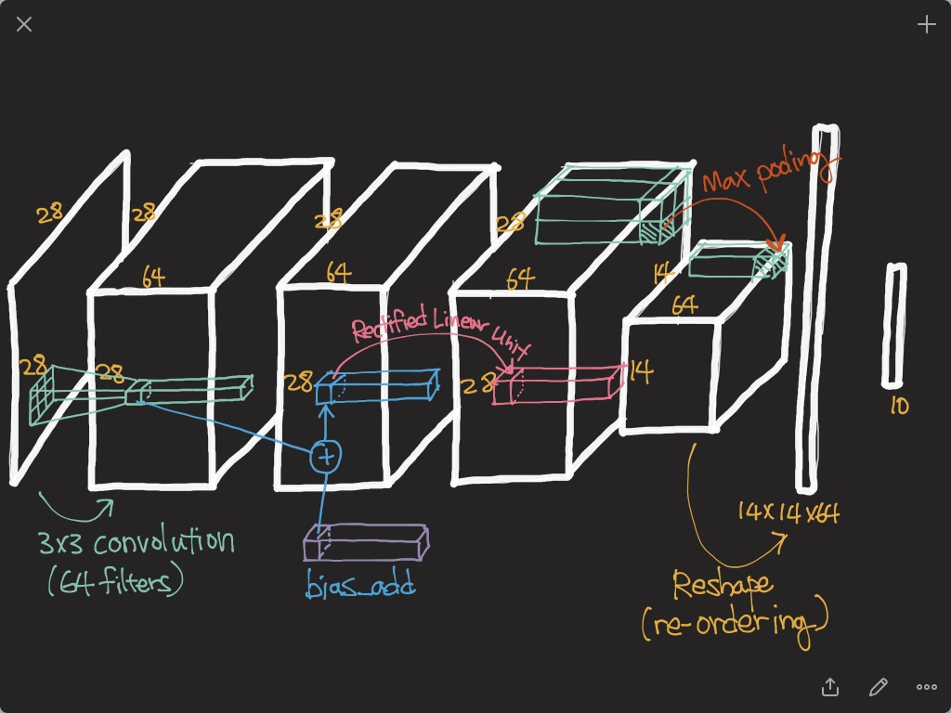

Slide 14
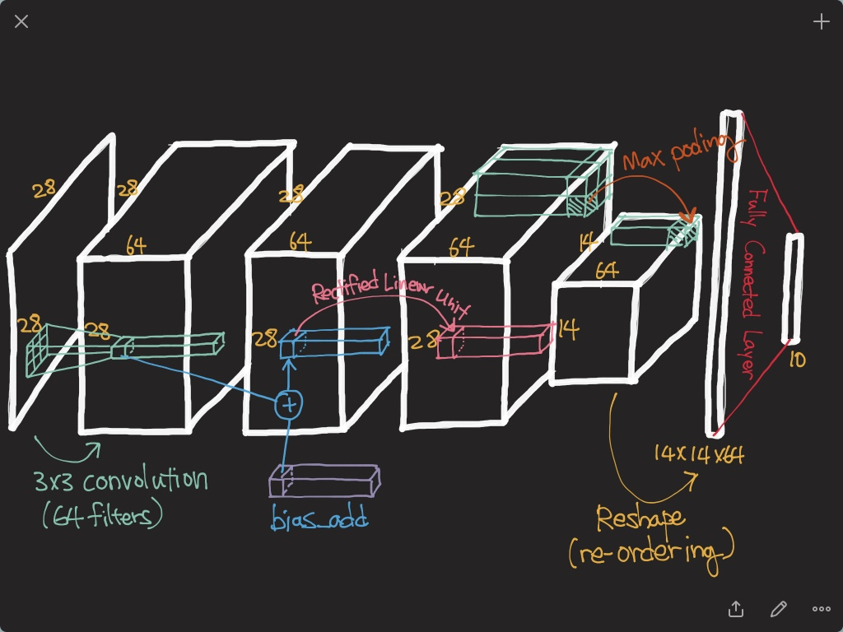

Slide 15
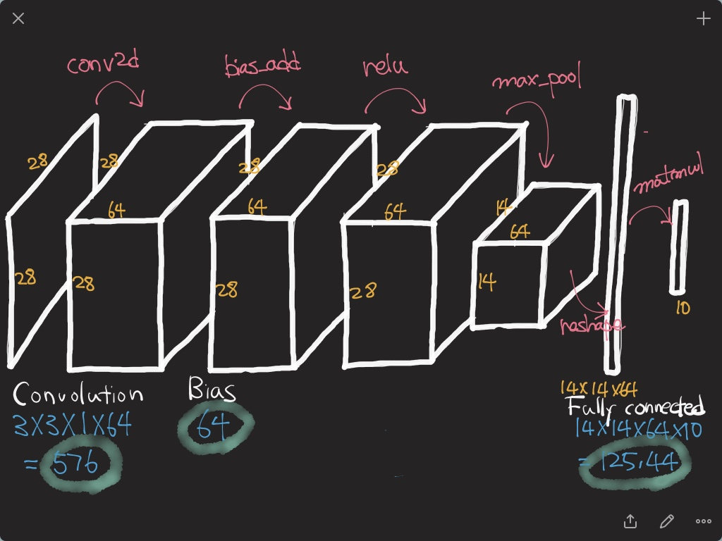

Slide 16
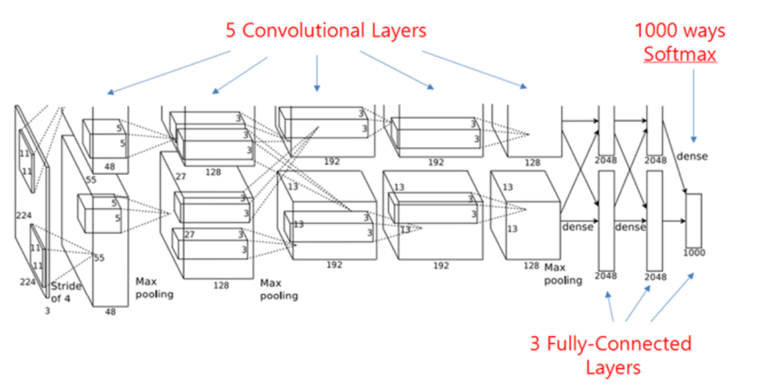
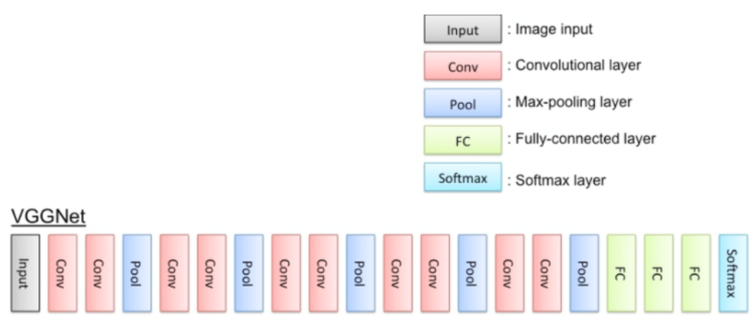
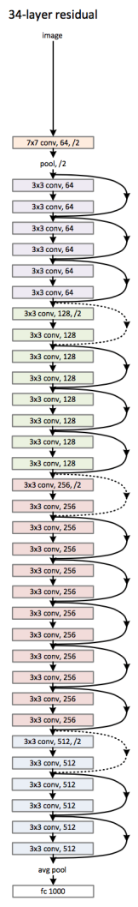
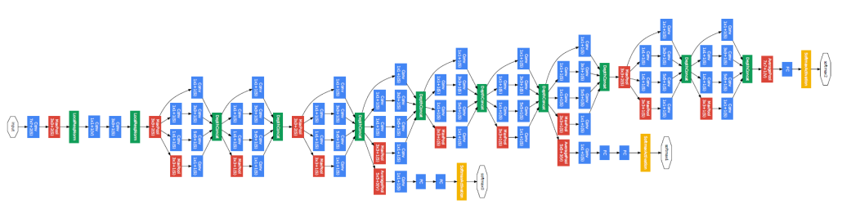
CNN Architectures
교재 p 269
AlexNet(ILSVRC 2012 winner)
VGG
GoogLeNet(ILSVRC 2014 winner)
ResNet(ILSVRC 2015 winner)
Notes:
CNN을 얘기할 때 반드시 언급되는 Architecture들인데요. 2012년 Image Net Challenge에서 AlexNet이 우승한 이래로 Image Classification에서는 CNN이 대세가 되었고,

Slide 17
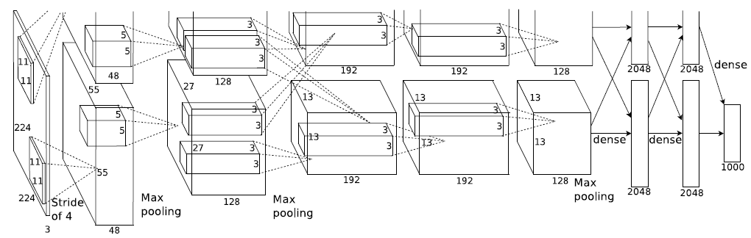
7.7.2 AlexNet
교재 p 258
What is the number of parameters?
Why are layers divided into two parts?

Slide 18
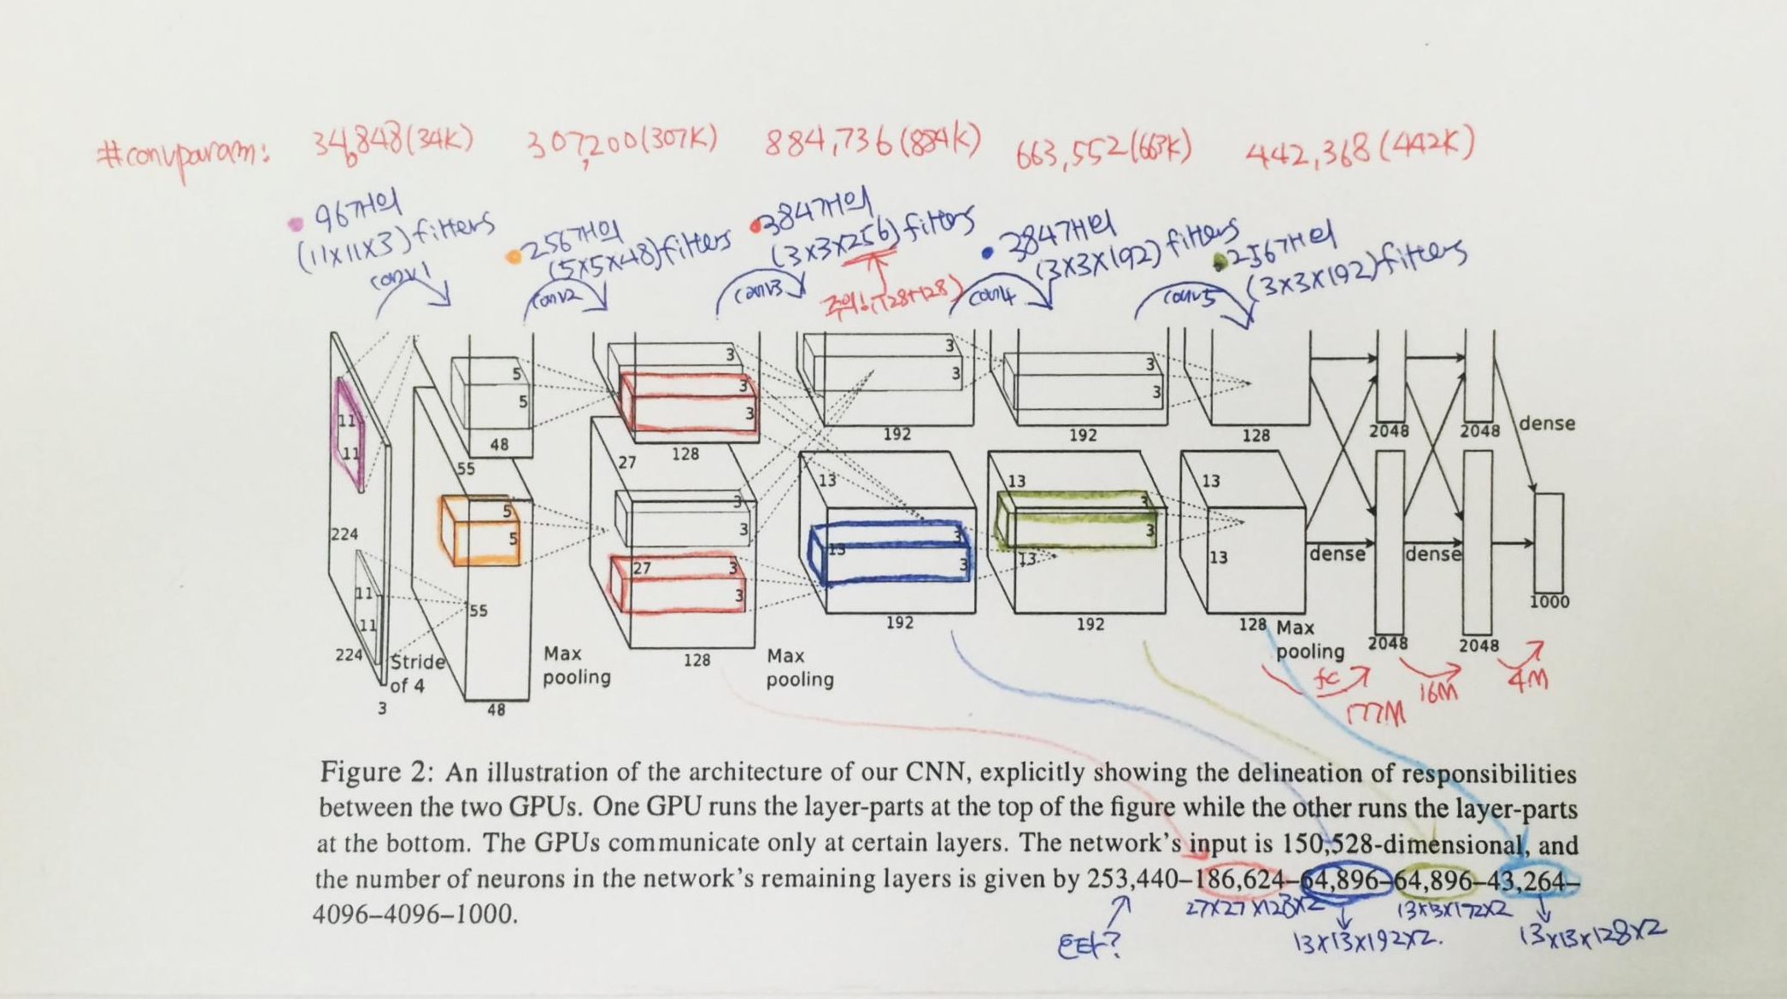
7.7.2 AlexNet

Slide 19
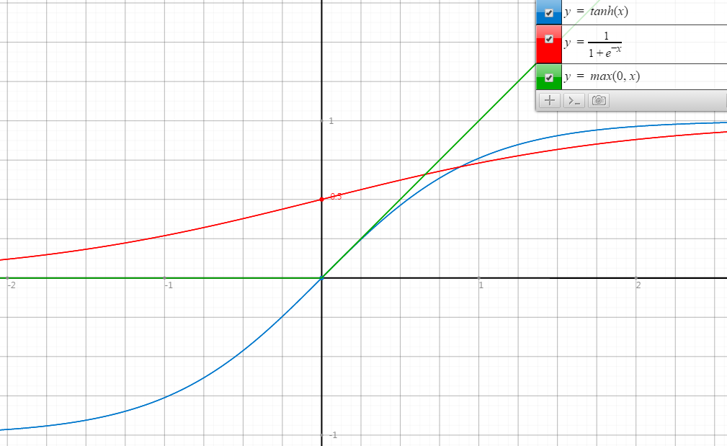
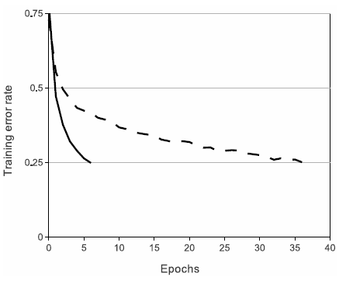
ReLU
교재 p 258
Rectified Linear Unit
ReLU
tanh
Faster Convergence!

Slide 20
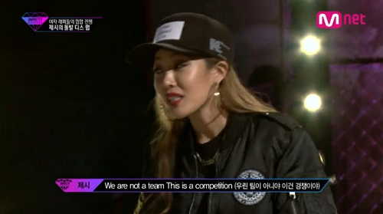
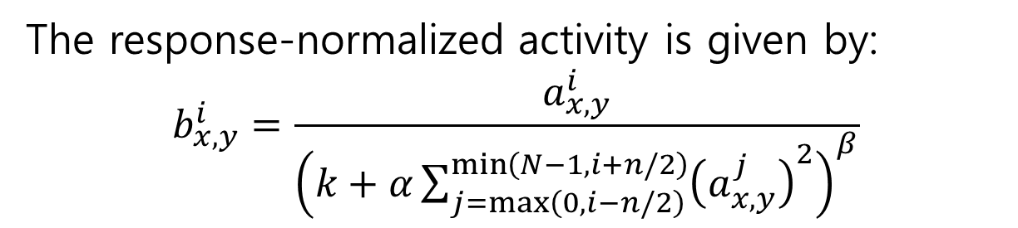
LRN
Local Response Normalization
교재 p 258
The response-normalized activity is given by:
$$b_{x,y}^{i}=\frac{a_{x,y}^{i}}{{\left(k+α\sum_{j=\max\left(0, i−n/2\right)}^{\min\left(N−1, i+n/2\right)}{{\left(a_{x,y}^{j}\right)}^{2}}\right)}^{β}}$$
It implements a form of lateral inhibition inspired by real neurons.

Slide 21

Regularization in AlexNet
Main objective is to reduce overfitting.
More details will be handled in next week.
In the AlexNet, two regularization methods are used.
Data augmentation
Dropout

Slide 22
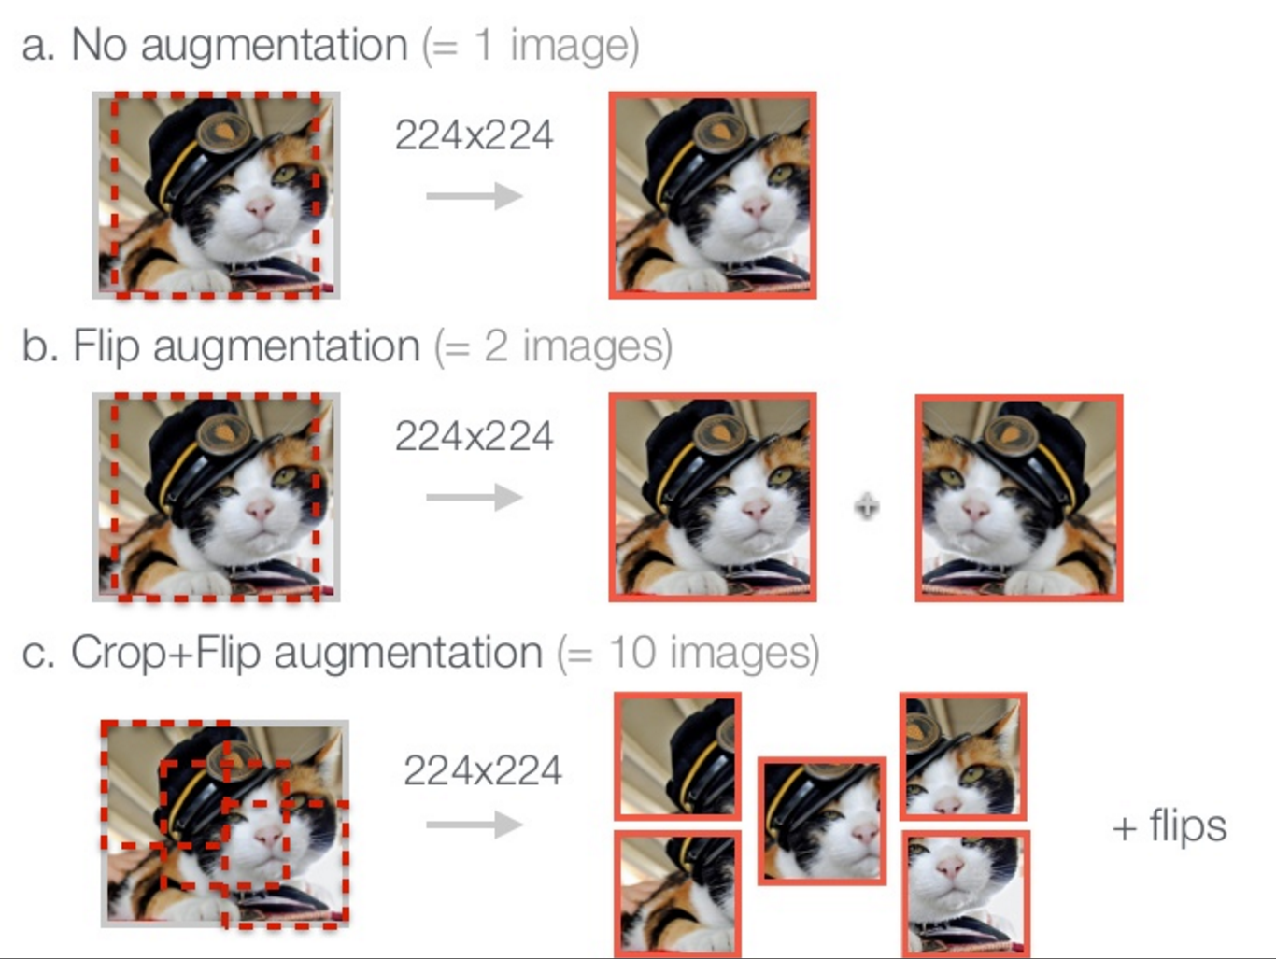
8.1.2 Data augmentation
교재 p 265
http://www.slideshare.net/KenChatfield/chatfield14-devil

Slide 23
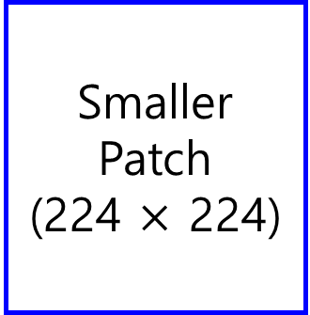

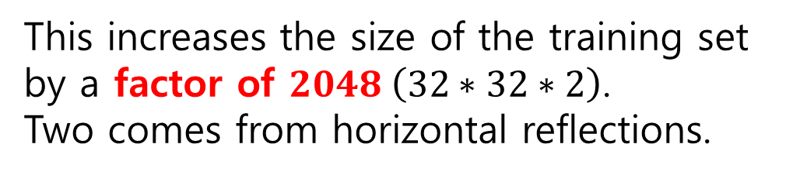
Data augmentation in AlexNet
Original Image
(256 $×$ 256)
Smaller Patch
(224 $×$ 224)
This increases the size of the training set by a factor of $2048 \left(32∗32∗2\right)$.
Two comes from horizontal reflections.

Slide 24
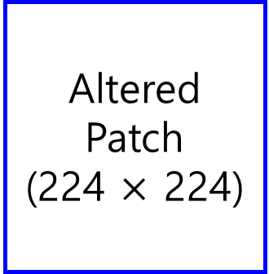
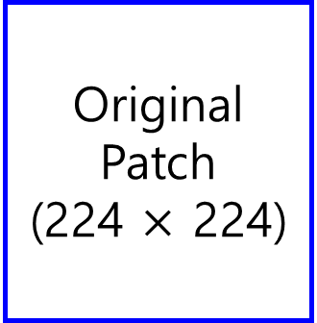
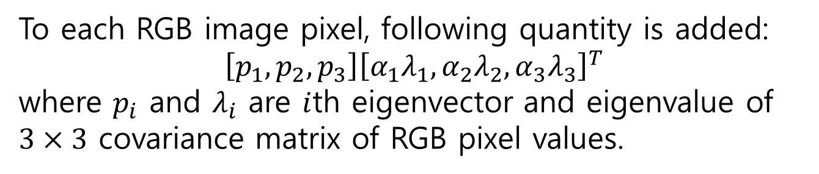
Data augmentation in AlexNet
Original Patch
(224 $×$ 224)
Altered Patch
(224 $×$ 224)
Color variation
To each RGB image pixel, following quantity is added:
$$\left[p_{1}, p_{2}, p_{3}\right]{\left[α_{1}λ_{1},α_{2}λ_{2},α_{3}λ_{3}\right]}^{T}$$
where $p_{i}$ and $λ_{i}$ are $i$th eigenvector and eigenvalue of $3×3$ covariance matrix of RGB pixel values.
Probabilistically, not a single patch will be same at the training phase! (a factor of infinity!)

Slide 25
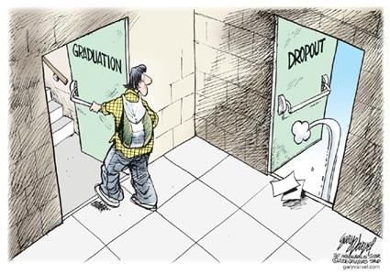
6.4.3 Dropout
Original dropout [1] sets the output of each hidden neuron with certain probability.
In this paper, they simply multiply the outputs by 0.5.
[1] G.E. Hinton, N. Srivastava, A. Krizhevsky, I. Sutskever, and R.R. Salakhutdinov. Improving neural networks by preventing co-adaptation of feature detectors. arXiv, 2012.
http://www.eddyazar.com/the-regrets-of-a-dropout-and-why-you-should-drop-out-too/

Slide 26
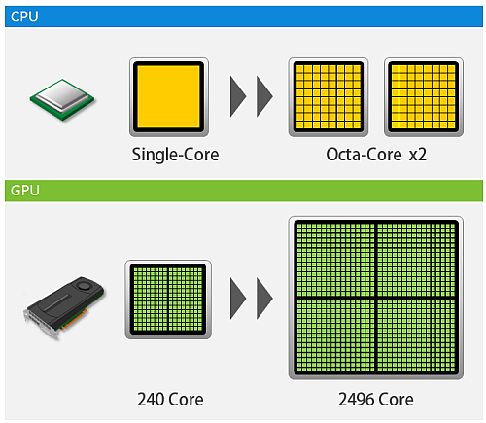
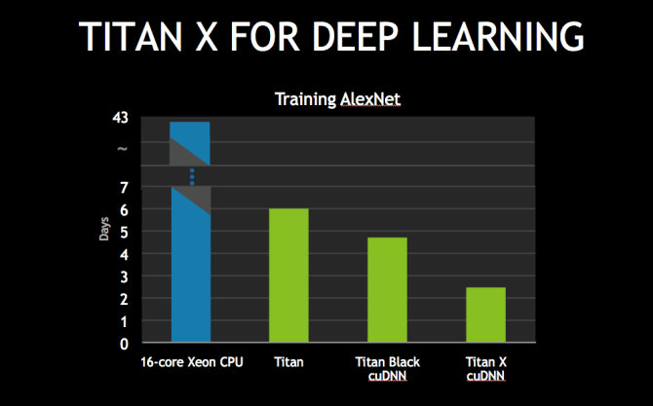
GPU? GPGPU?
교재 p 258
Graphics Processing Unit
General-purpose computing on graphics processing units
http://www.hpc.co.jp/images/cpu_gpu_image.png
Notes:
Alex net이 성과를 낼 수 있었던 원동력 중 하나가 바로 GPU를 계산에 동원했던 것인데요. GPU는 Graphics Processing Unit의 약자이고 흔히 그래픽 가속장치라고도 불리우는 부품입니다.

Slide 27
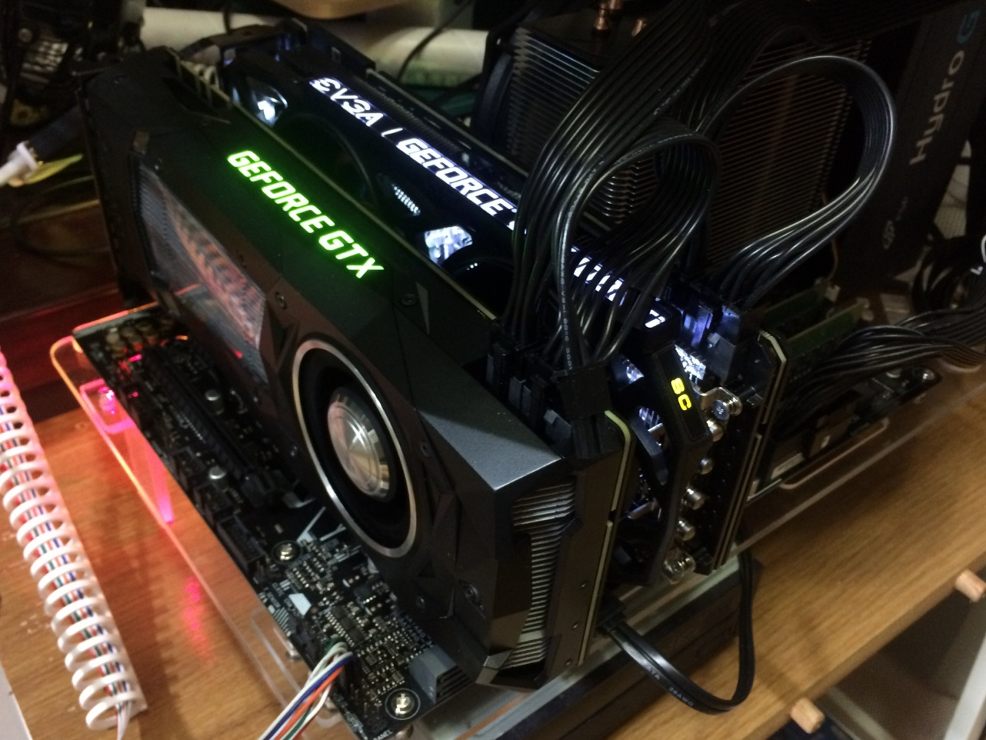
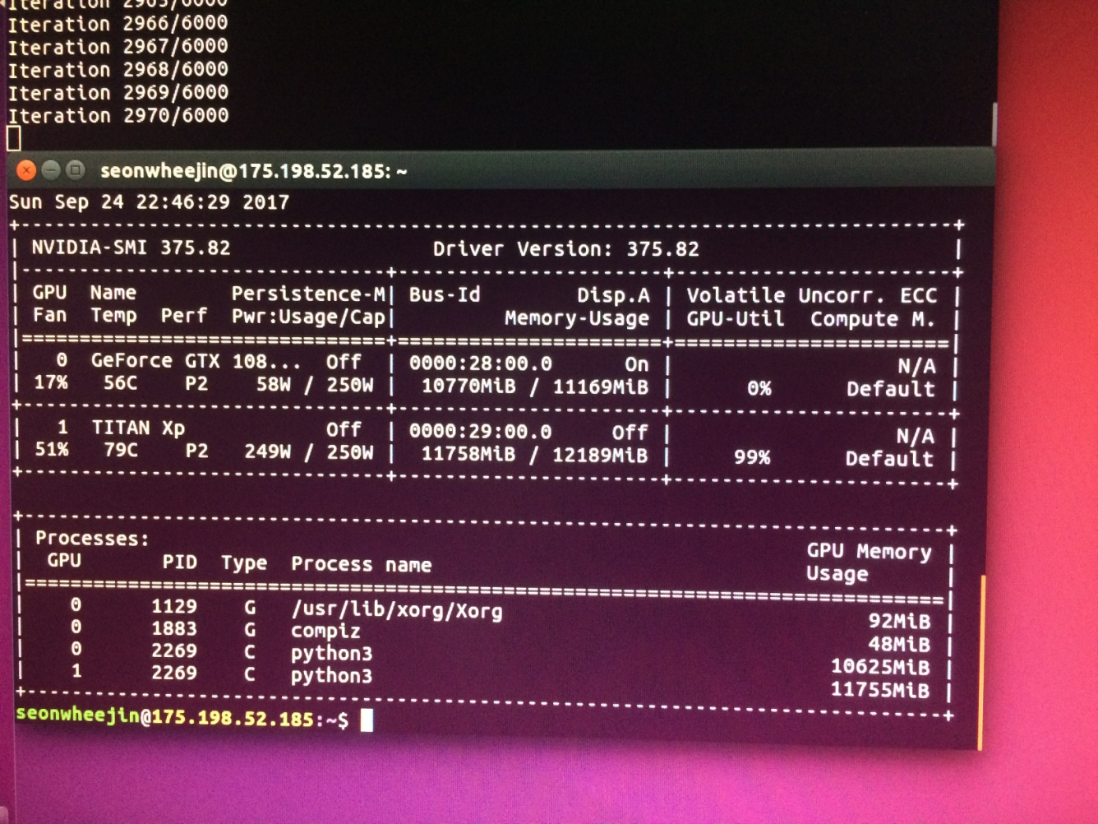
Custom Deep-Learning Machine
FSP Hydro G 850W
191,500 Won (2017. 8)
nVidia GeForce Titan Xp
1,650,000 Won (2017. 8)
nVidia GeForce GTX 1080Ti
1,080,000 Won (2017. 8)

Slide 28
교재 p 270
8.2.2 VGG

Slide 29
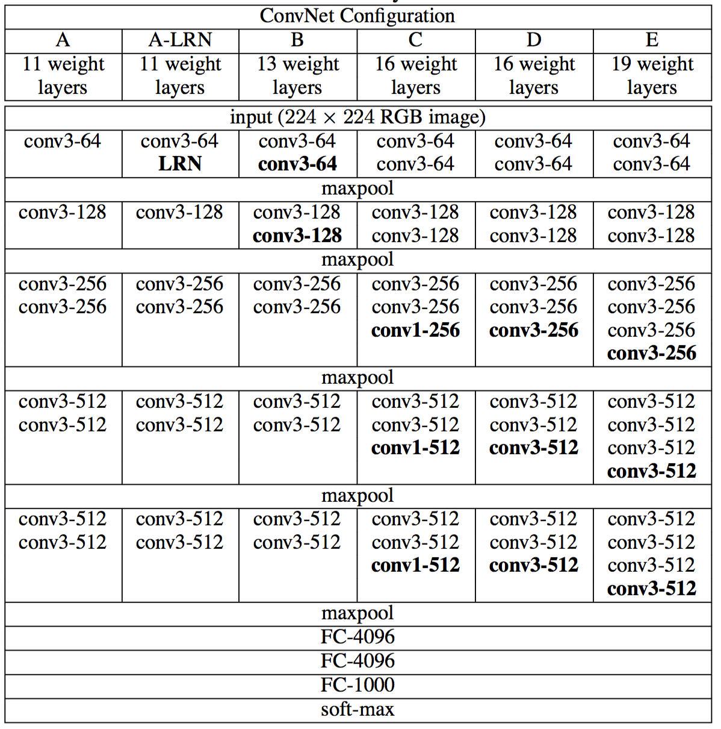
VGG?

Slide 30
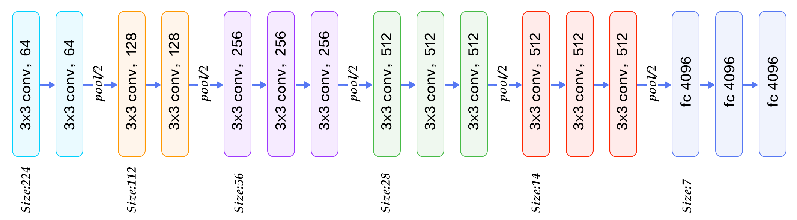

VGG-19

Slide 31
교재 p 271
8.2.3 GoogLeNet

Slide 32


GoogLeNet
+ LeNet

Slide 33

GoogLeNet
최소한의 파라미터로 최대한 Deep Network를 쌓아보자!
22 Layers Deep Network
Efficiently utilized computing resources, “Inception Module”
Significantly outperforms previous methods on ILSVRC 2014

Slide 34
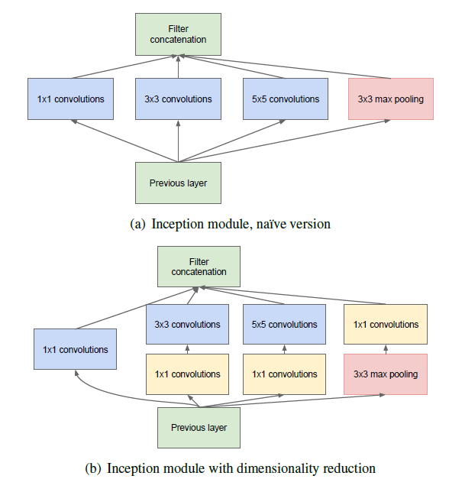
Inception module
Going deeper with Convolution

Slide 35
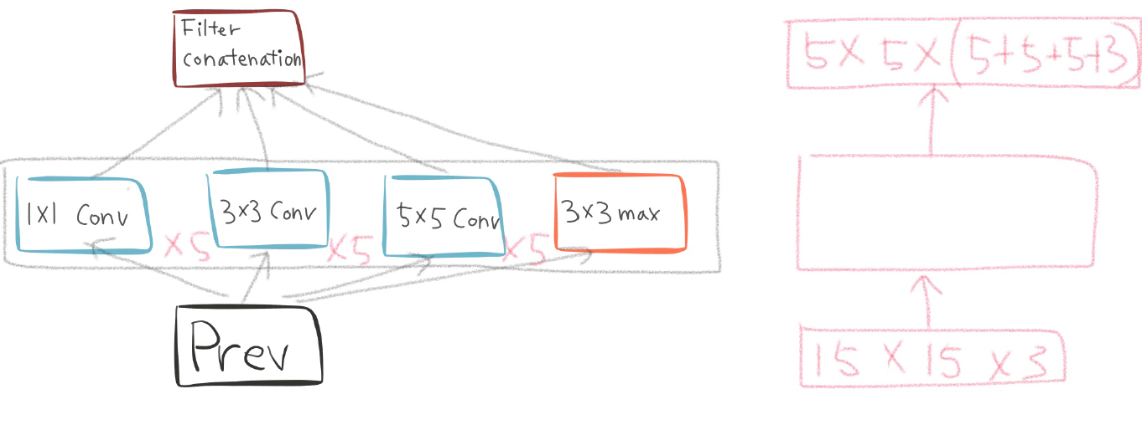
Naïve inception module
Filter : 3
Stride : 3

Slide 36
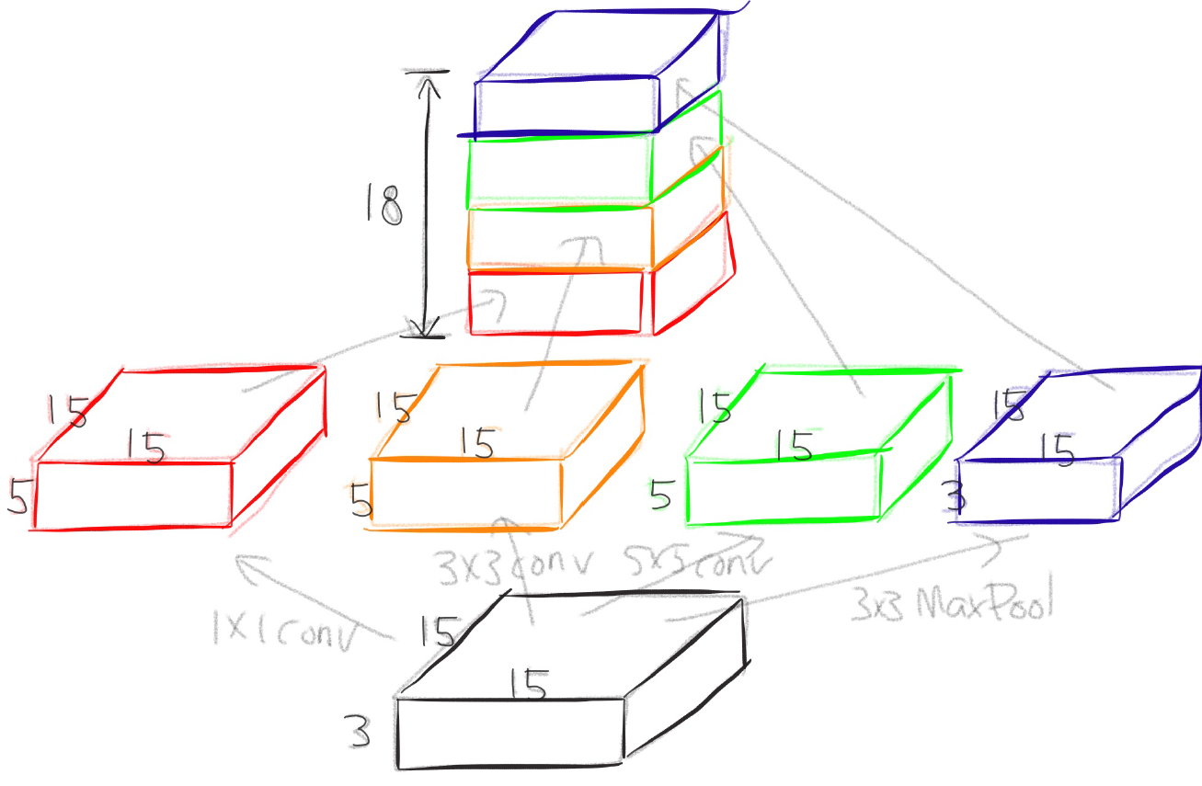
Naïve inception module

Slide 37
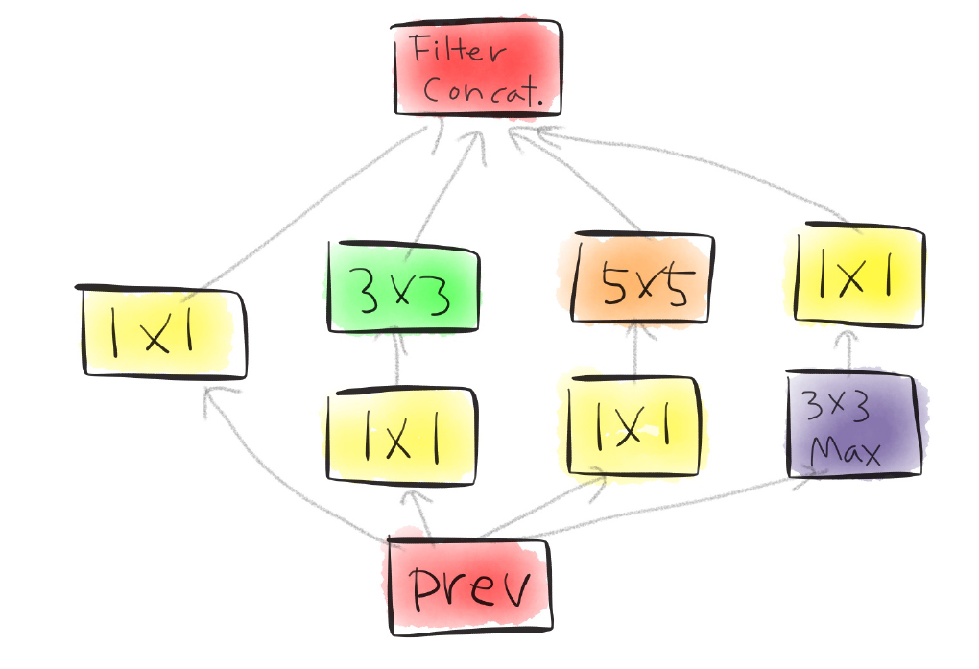
Actual inception module
?
?
?

Slide 38
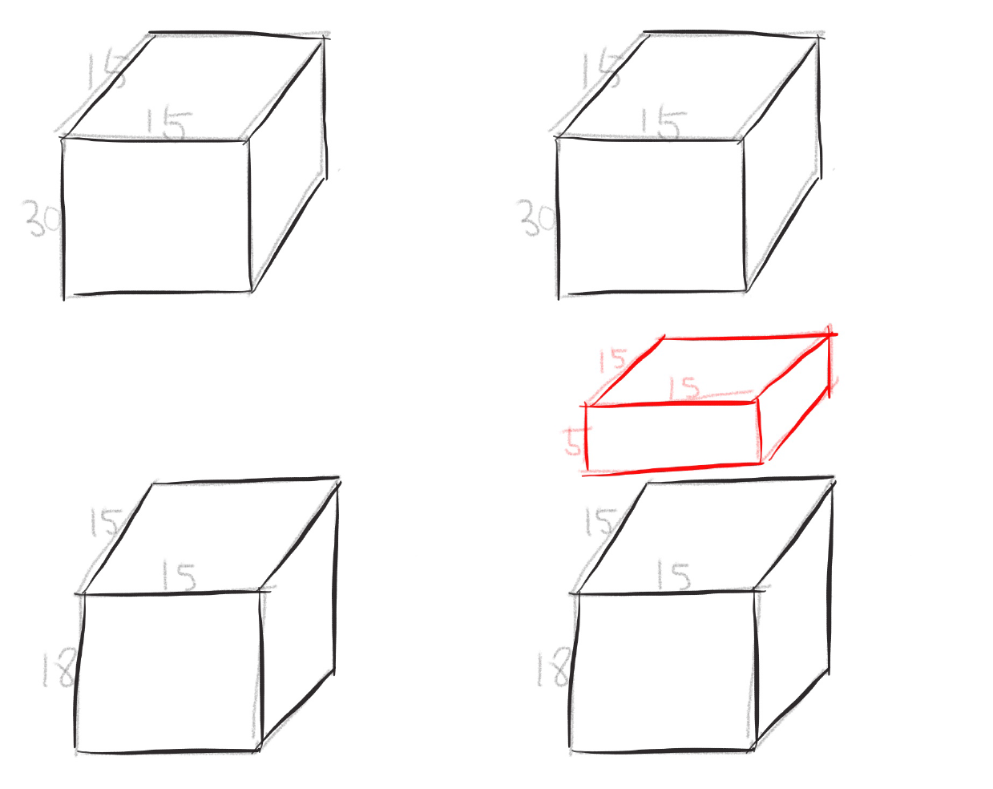
One by one convolution

Slide 39
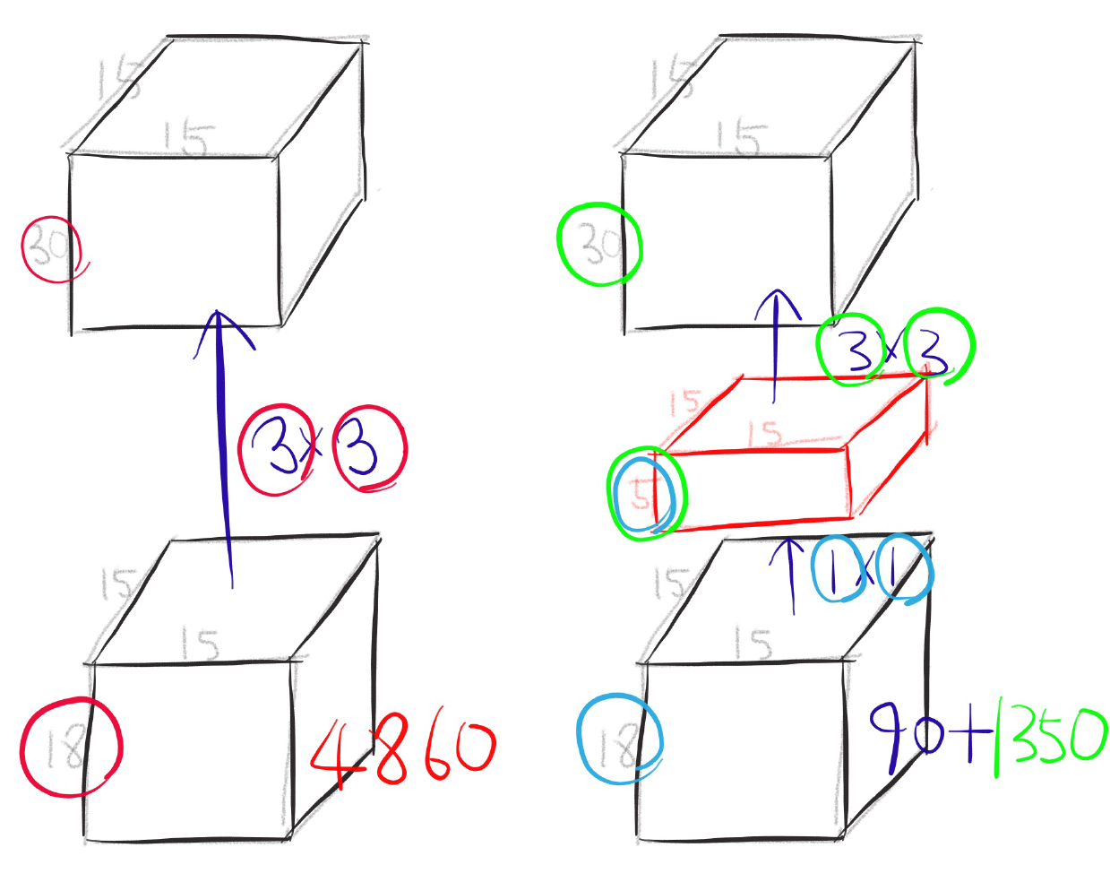
One by one convolution

Slide 40
GoogLeNet
Network in Network!

Slide 41
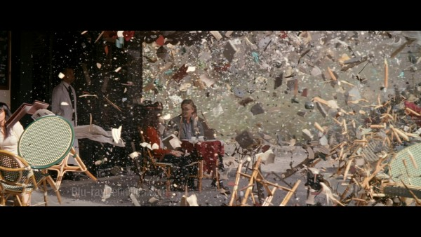
Conclusion
Very clever idea of using one by one convolution for dimensionality(channel 정보) reduction!
Other than that...

Slide 42
8.2.4 ResNet

Slide 43
Deep residual networks
152 layers network
1st place on ILSVRM 2015 classification task
1st place on ImageNet detection
1st place on ImageNet localization
1st place on COCO detection
1st place on COCO segmentation

Slide 44
Deeper Network?
Is deeper network always better?
What about vanishing gradients? p204 참조
Better initialization methods(6.2) / batch normalization (6.3) / ReLU
Any other problems?
Overfitting? p215 참조
Degradation problem: more depth but lower performance

Slide 45
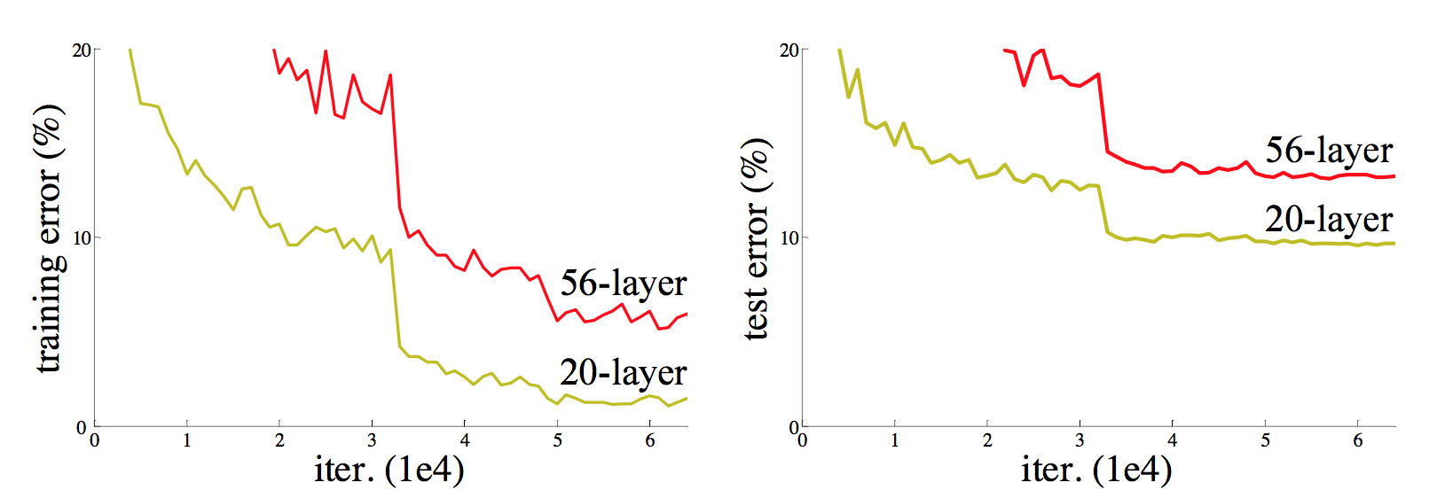
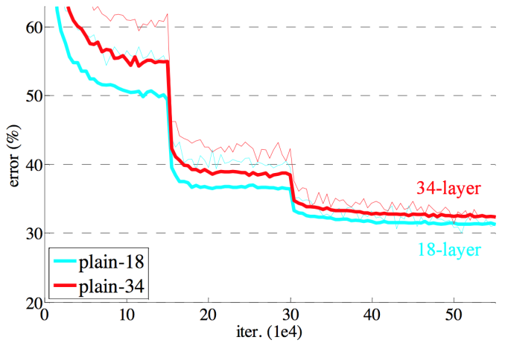
Degeneration problem
CiFAR 100 Dataset
ImageNet

Slide 46
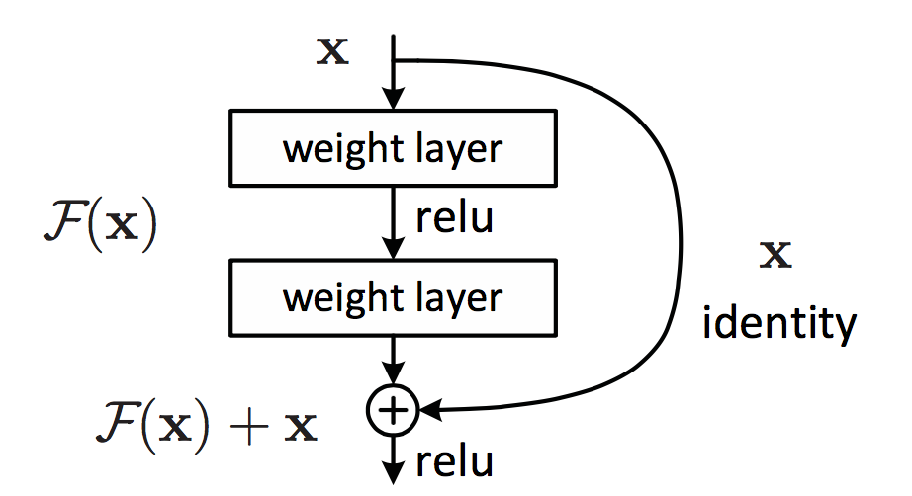
Residual learning building block

Slide 47
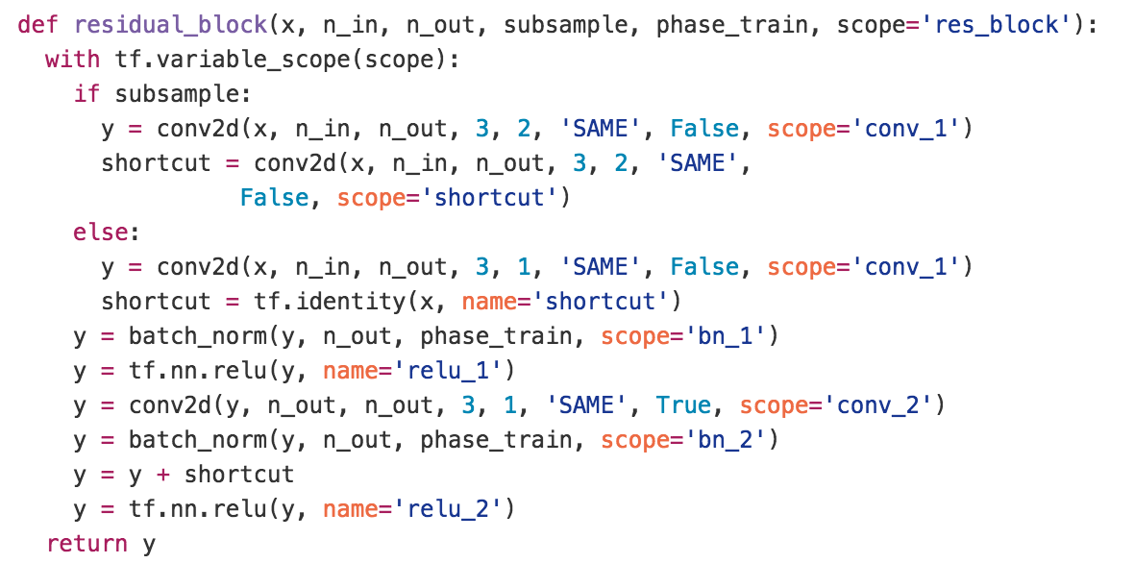
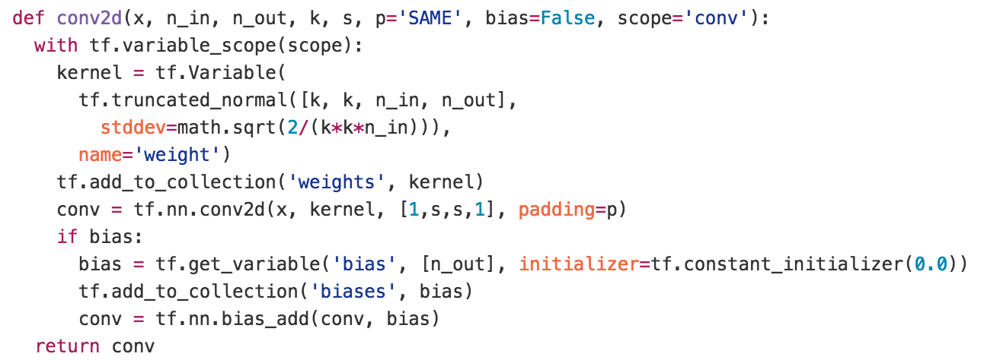
Residual learning building block
y
ReLU
+
y
conv2d
y
ReLU
y
conv2d
x

Slide 48
Why residual?
We hypothesize that it is easier to optimize the residual mapping than to optimize the original, unreferenced mapping.
Shortcut connections are used.

Slide 49
Why residual?
“The extremely deep residual nets are easy to optimize. “
“The deep residual nets can easily enjoy accuracy gains from greatly increased depth, producing results substantially better than previous networks. “

Slide 50



Residual mapping
Basic residual mapping (same dim.)
“But we will show by experiments that the identity mapping is sufficient for addressing the degradation problem and is economical, and thus W is only used when matching dimensions.”
Basic residual mapping (different dim.)

Slide 51


Deep residual network

Slide 52


Deeper bottle architecture
Dimension reduction
Convolution
Dimension increase

Slide 53


Experimental results

